Slide 1
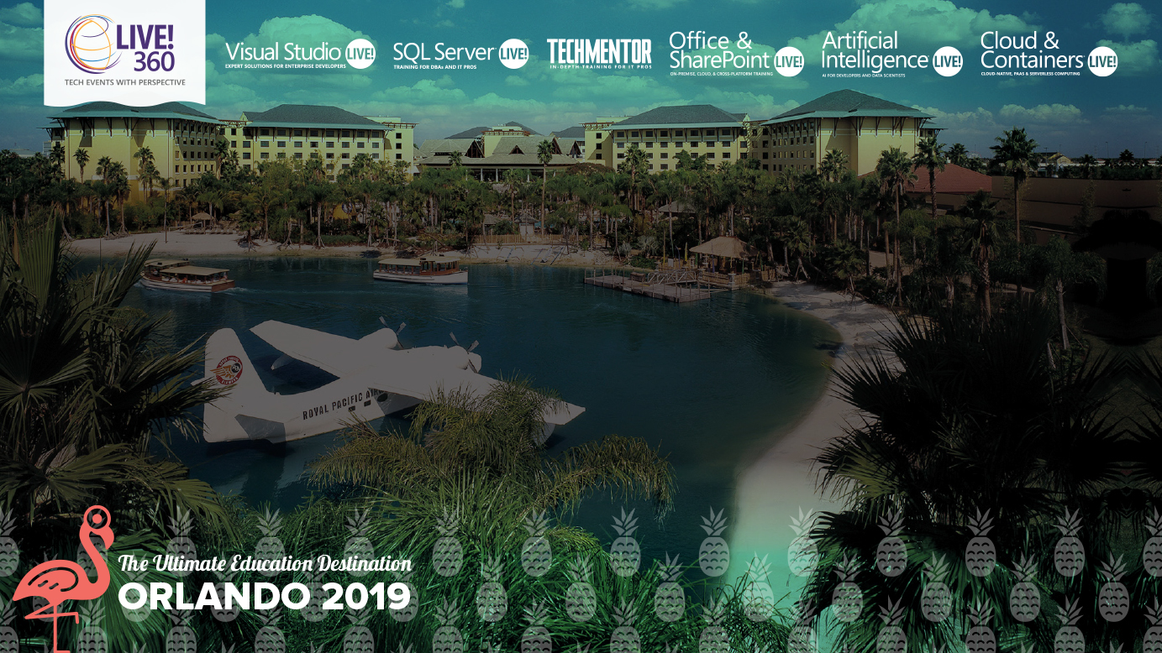
How Cloud Native Impacts your Development, Deployment and Operations
Steve Lasker
Program Manager
Azure Container Registries
Steve.Lasker@Microsoft.com
@SteveLasker
SteveLasker.blog
Notes:
Containers have become the modern packaging format, regardless of the host they're run on. You may be building your own images, or consuming images from ISVs. While containers have a focused subset of their VM ancestors, containers still have layers of the OS, runtimes and other components that are susceptible to vulnerabilities that must be remediated. Have you considered how you'll patch these deployments? Will you patch the running containers, as you patch VMs, hoping the software continues to run, as you continually patch the same deployed image?
We'll examine leveraging your build and deployment pipelines to automatically patch, test and deploy updates, during and long after you've moved onto another project. OS & Framework Patching can be an extension of what you're already doing today.

Slide 2
Cloud native is the new paradigm of software development
35
>
%
of all production apps will be cloud-native by 2022¹
¹IDC FutureScape, 2018
Notes:
SPEAKER: New paradigm of application development
The rapid rise of new digitally native businesses have disrupted traditional business models and destabilized established companies and industry sectors. The grounds for competition have changed – enterprises are increasingly defined by the way they build software. Challenger banks, online healthcare providers, e-commerce leaders and other upstarts are winning customers by providing new applications.
All these trends have yielded a new paradigm of software development called cloud native.
IDC predicts by 2022, 35% of all production apps will be cloud-native vs. less than 10% today
IDC: https://www.idc.com/getdoc.jsp?containerId=prUS44417618

Slide 3
Cloud Native
What…
Where…
Why…

Slide 4
What Is Cloud Native?
Infra Deployed Through APIs Deployments are software requests, not hardware purchase ..
Automation
All process, from build, patching, test, . deployment are automated
Serverless
Instancing infrastructure, on-demand, paying . for usage over reserved capacity .
Microservices
Loosely coupled services, using fire & forget queue processing with apology-based transactions
Containers.
Standard deployment format to. abstract code from underlying. infrastructure differences
OSS
Embraces community projects to speed development
Failure As A Design Principal .
Standard deployment format to abstract code . from underlying infrastructure differences
Polyglot
Mixture of languages & runtimes, tailored to the development team, and/or task being done
Notes:
SPEAKER: What is cloud native
‘Cloud-native’ is an adjective that describes the applications, architectures, platforms/infrastructure, and processes, that together make it economical and possible for us to quickly respond to changing landscape and growing customer needs.
In simple terms, it is application code and dependencies packaged in containers, deployed as microservices, and exposed as APIs. And you can manage them using DevOps processes and tools.

Slide 5
Where Is Cloud Native?
Resources Provisioned On Demand
Pay for the usage .
Point Of Presence
Continental & regional deployment, providing cross region connectivity
On The Go .
With Azure Stack Edge, any location is possible . Hardened, mobile backpacks to temporary . shipping container deployments
On Prem
Azure Stack, . On-prem to extend Azure owned . regions to your points of presence
Notes:
SPEAKER: What is cloud native
‘Cloud-native’ is an adjective that describes the applications, architectures, platforms/infrastructure, and processes, that together make it economical and possible for us to quickly respond to changing landscape and growing customer needs.
In simple terms, it is application code and dependencies packaged in containers, deployed as microservices, and exposed as APIs. And you can manage them using DevOps processes and tools.

Slide 6
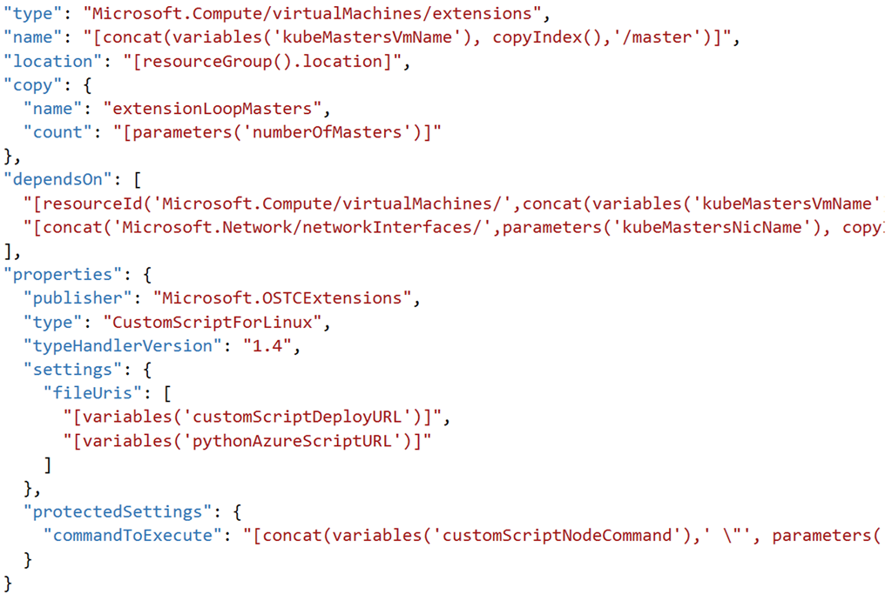
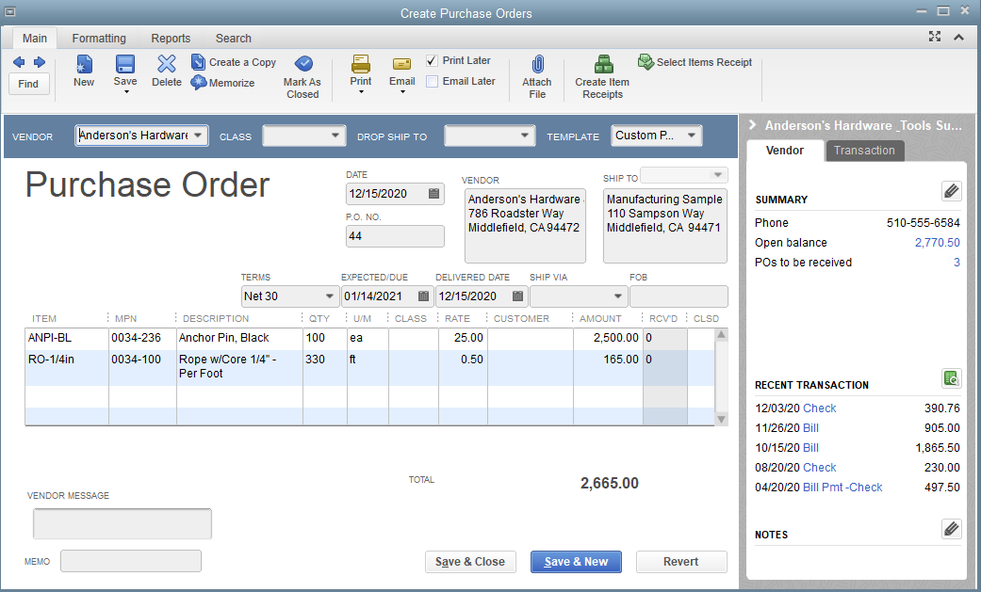




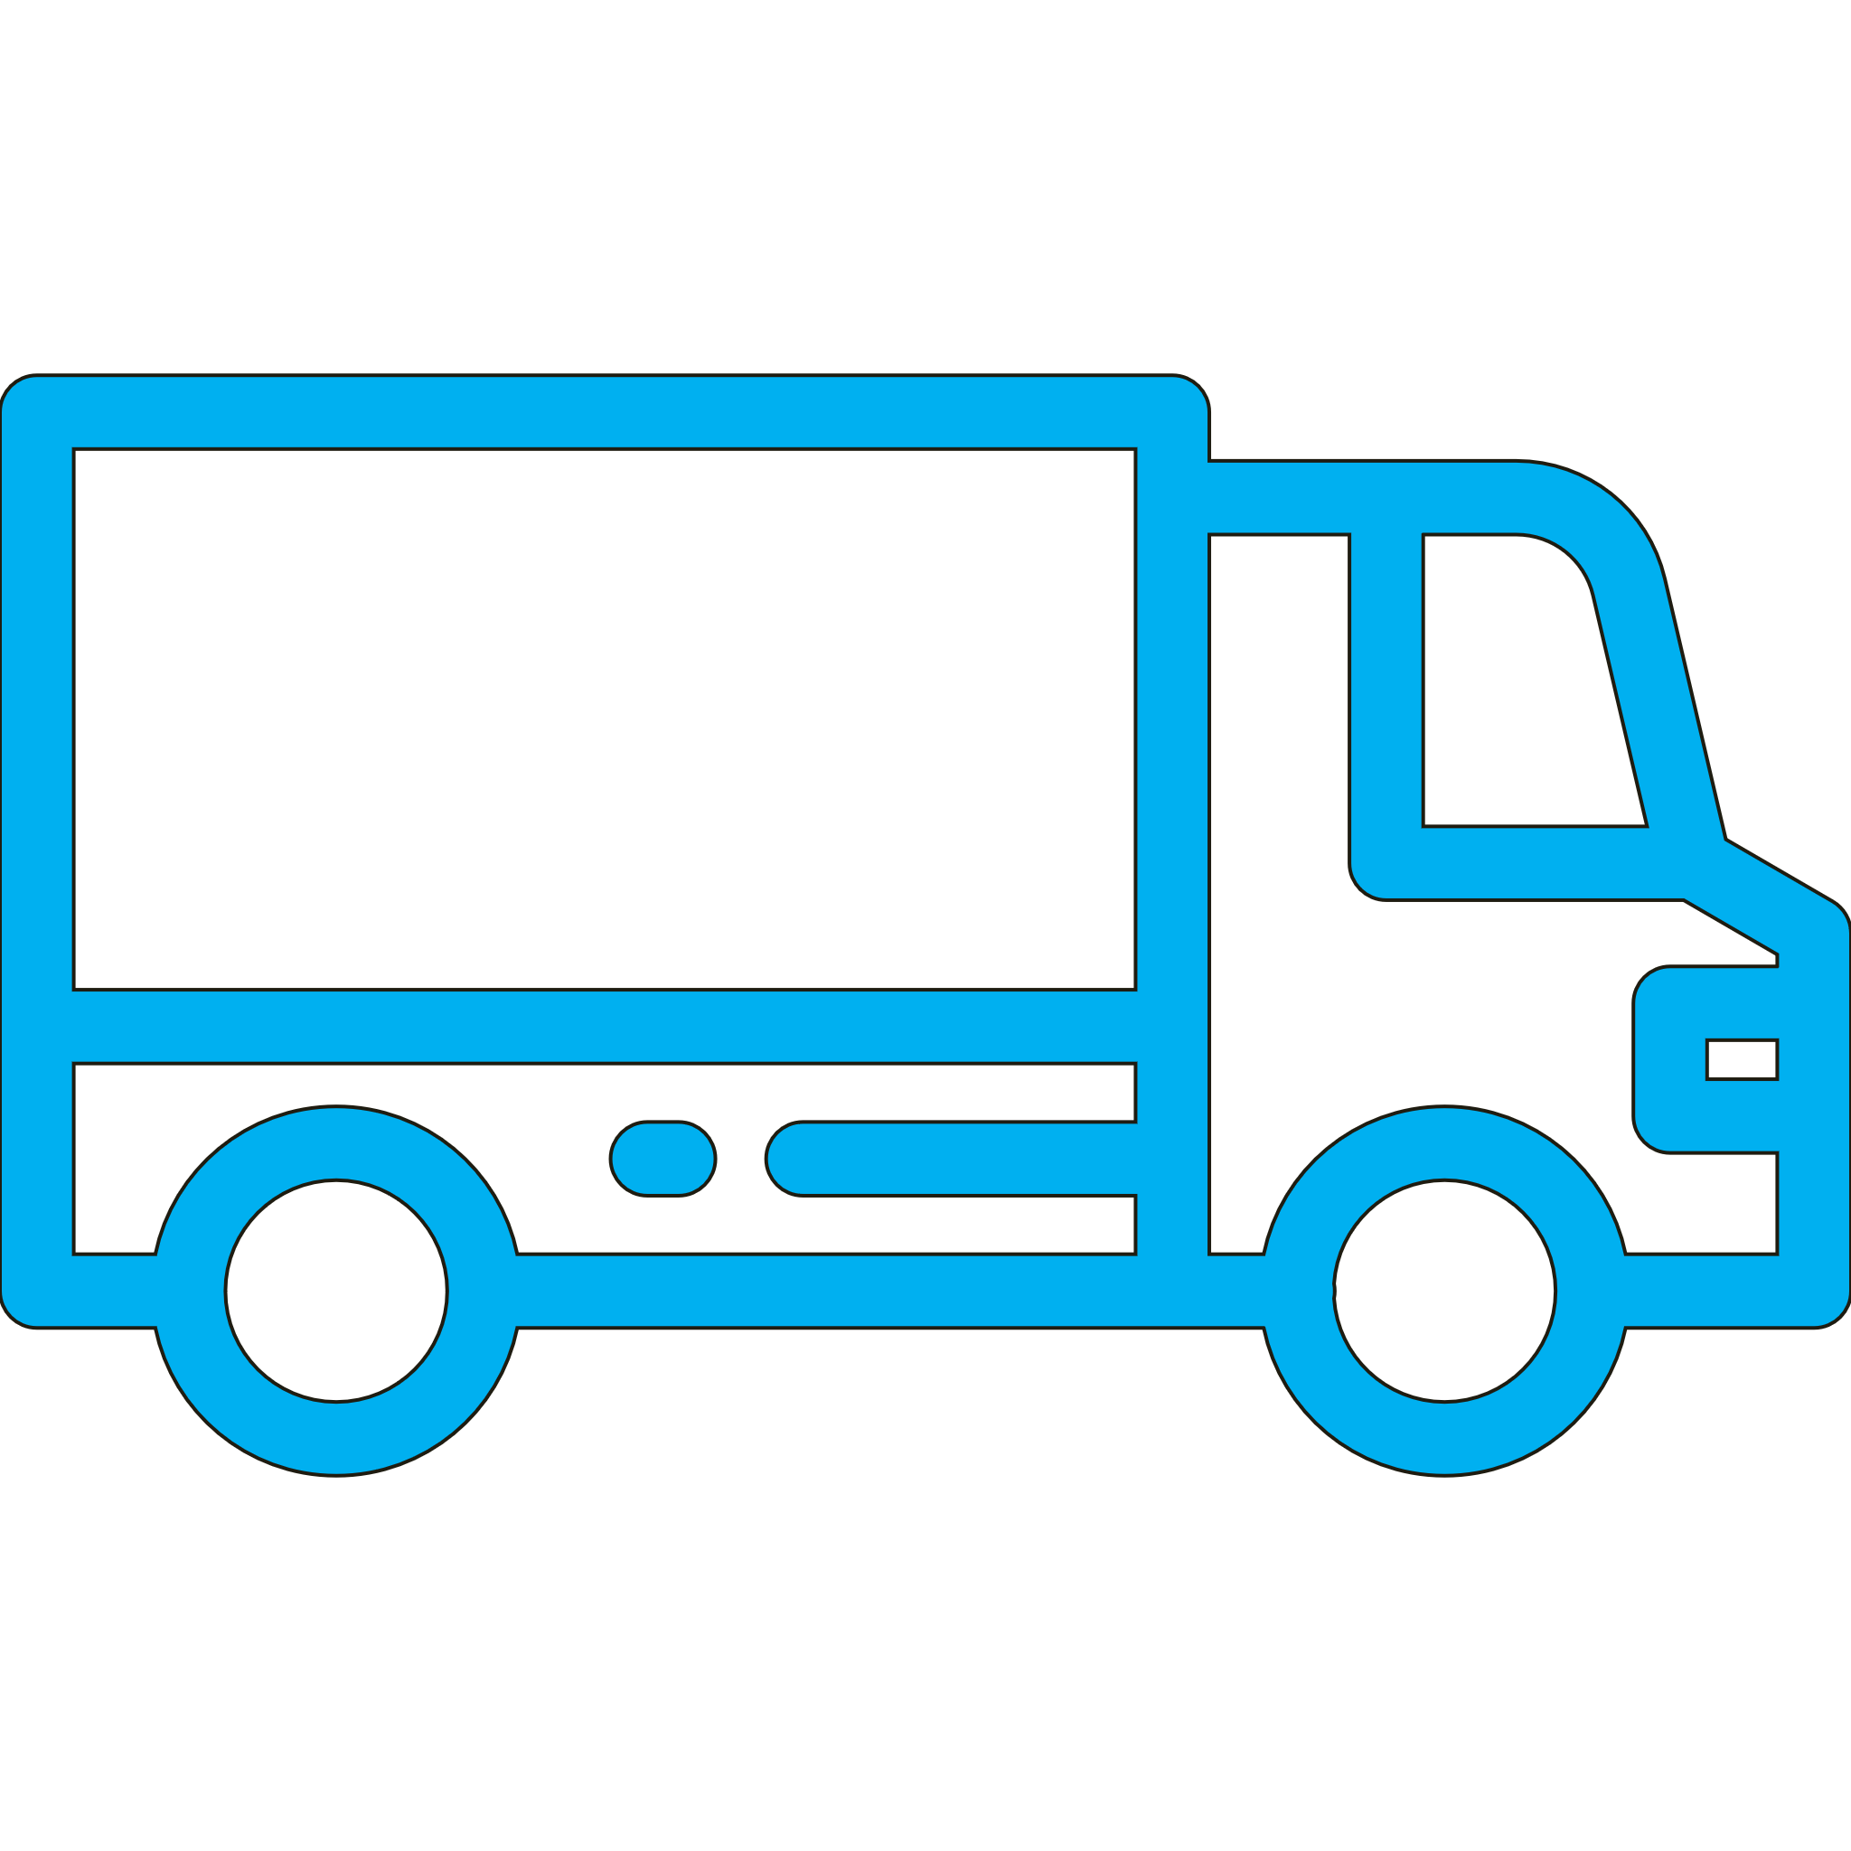
Resources Provisioned On Demand
With Documents & Shipping Companies?
With APIs & Containers
ARM
Helm
Terraform
CNAB

Slide 7
Azure Points Of Presence
Norway West
Norway East
West Europe
Germany West Central
North Europe
UK South
Germany North
West US 2
US Gov Iowa
Canada East
UK West
Germany Northeast
Central US
Canada Central
France Central
Germany Central
China North
China North 2
West Central US
France South
Switzerland North
West US
North Central US
Switzerland West
Korea Central
US Gov Arizona
US DoD East
Korea South
Japan East
South Central US
East US
Japan West
East US 2
UAE North
China East 2
China East
US Gov Texas
US Gov Virginia
US DoD Central
UAE Central
West India
East Asia
54
Central India
South India
Southeast Asia
Azure regions
More than AWS & Google combined
Brazil South
South Africa North
South Africa West
Australia East
Australia Southeast
Australia Central
Australia Central 2
Available region
Announced region
Availability zones

Slide 8

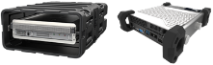
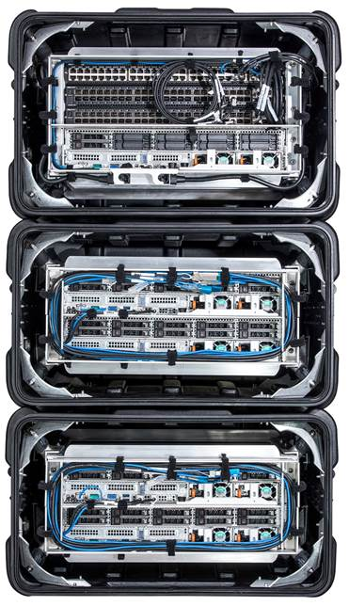
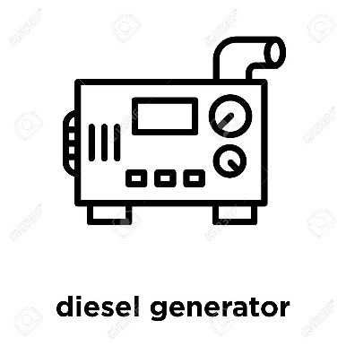

On Demand & On the Go
Resources Provisioned On Demand
Pay for the usage .
Point Of Presence
Continental & regional deployment, providing cross region connectivity
On The Go .
With Azure Stack Edge, any location is possible . Hardened, mobile backpacks to temporary . shipping container deployments
On Prem
Azure Stack, . On-prem to extend Azure owned . regions to your points of presence
Notes:
SPEAKER: What is cloud native
‘Cloud-native’ is an adjective that describes the applications, architectures, platforms/infrastructure, and processes, that together make it economical and possible for us to quickly respond to changing landscape and growing customer needs.
In simple terms, it is application code and dependencies packaged in containers, deployed as microservices, and exposed as APIs. And you can manage them using DevOps processes and tools.

Slide 9
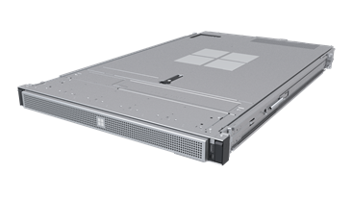
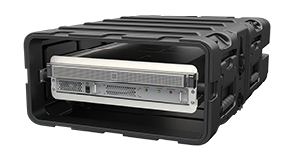
New Azure Stack Edge
PREVIEW
Network add-on (MEC)
Commercial Series
Rugged Series

Slide 10
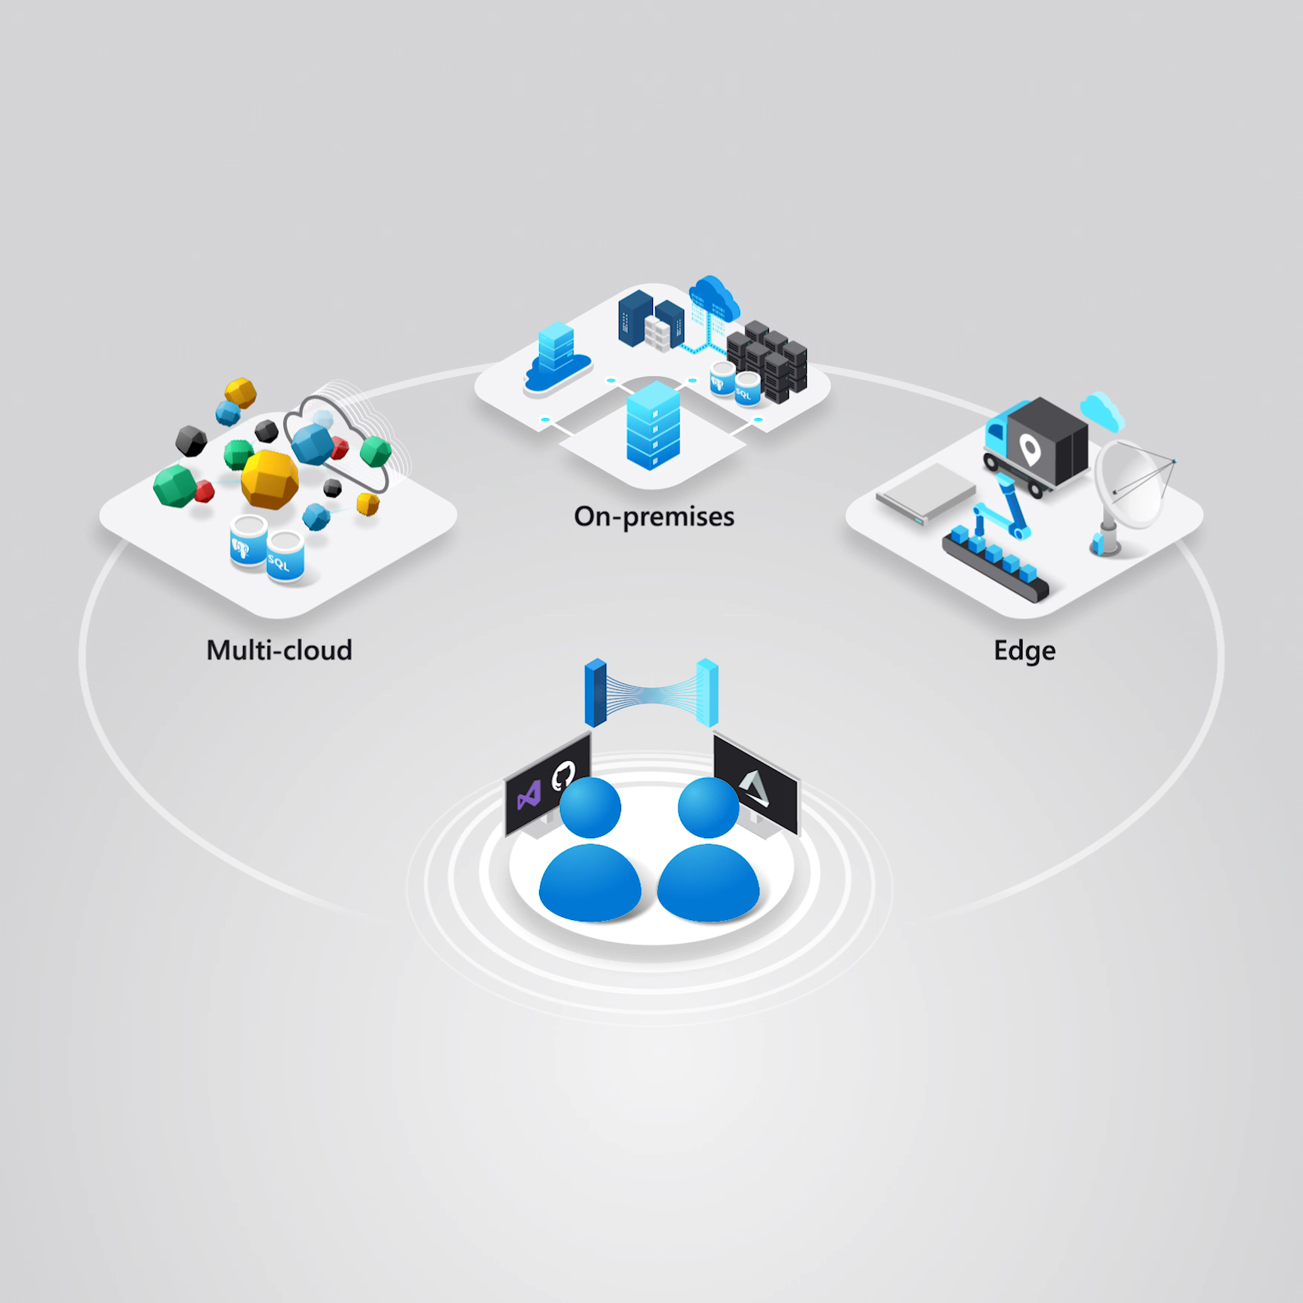

Slide 11
Azure Arc
Bring Azure services and management to any infrastructure
Run Azure data services anywhere
Extend Azure management across your environments
Adopt cloud practices on-premises
Implement Azure security anywhere
Azure Arc is a set of technologies that extends Azure management and enables Azure services to run across on-premises, multi-cloud, and edge.

Slide 12
Cloud is…
Infrastructure, PaaS, SaaS managed by someone else
Provisioned with APIs
Spans existing global data centers
Expands to your points of presence

Slide 13
Serverless vs. Containers
&
Serverless & Containers are
Peanut Butter & Jelly
Needed
Security – Container Isolation
Any Image, Anywhere

Slide 14
Serverless
Provision resources as you need them
Scales from zero, to infinity
You focus on the “code”
No infrastructure management
An evolution, moving up the stack
and beyond

Slide 15

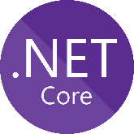
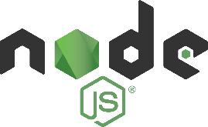
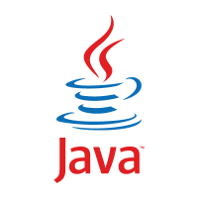
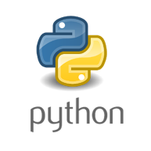
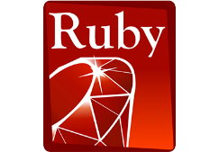




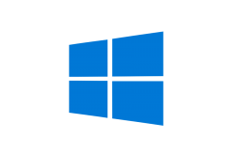

Serverless
Invocation
Response
contoso.azurecr.io/warranty/checkstatus:ab2q
<Code>
3.0preview
Version
9.341
2.1
9
1
Storage
Languages & runtimes
Secrets
Config

Slide 16
Serverless
Provision resources as you need them
Scales from zero, to infinity
You focus on the “code”
No infrastructure management
An evolution, moving up the stack
and beyond
, …or your container

Slide 17
By 2022
75
>
%
of global organizations will be running containerized applications in production¹
¹Gartner.
Notes:
Full statistic sources
Gartner. “6 Best Practices for Creating a Container Platform Strategy.” April 23, 2019. https://www.gartner.com/smarterwithgartner/6-best-practices-for-creating-a-container-platform-strategy/

Slide 18
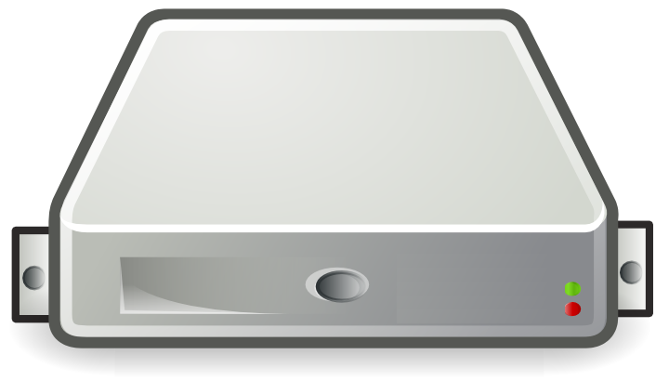
Getting To Serverless
Guest OS #5
Guest OS #6
Guest OS #7
Guest OS #8
Multi-tenant, (Hostile) isolation
Noisy Neighbor
CPU, Disk, Memory Allocation
Networking
Azure Management
Azure Diagnostics
Customer VNet & FW Rules
Customer Access control
Billing
Serverless (ACI)
Guest OS #1
Guest OS #2
Guest OS #3
Guest OS #4
Purchase VMs
Azure Offering
Purchase Rack Space
Hyper Visor
Typical Data Center Offering

Slide 19
Serverless & Containers
Needed
Security – Container Isolation – in flight
Any Image, Anywhere – limited by instancing speed
Now! - Speed

Slide 20
Teleporting Containers
Announcing:
Project Teleport removes the cost of download and decompression by mounting pre-expanded layers from the Azure Container Registry to Teleport enabled Azure container hosts.
Demo

Slide 21
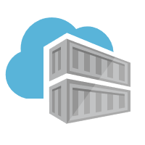

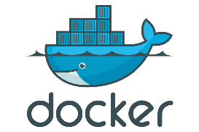





Docker Pull Flow
Pull:
I want this “thing”, represented by a collection of layers
docker pull demo42.azurecr.io/batchjob:v1
Manifests
1. Pull
Manifest:
List of layer ID’s representing the entire thing
Manifest:
What layers do I already have?
^{(decompressed)}
2. Manifest Returned
spark-notebook
3. Delta Layer Requests
ubuntu
debian
Image Cache
IMAGE ID REPOSITORY TAG SIZE
694950fbcb3f batchjob v1 5.65 GB
4. Layer URLs Returned
Layers Please:
List of compressed blob URLs
Compressed Layers
5. Layer Request
cf4ecb49238476635f551fe11987ae4c3
e41864ee12411ff073f0a58417cf7e160
85bef57c324acc96f7067488d35b7e3c1
Layer Cache
LAYER ID
1d57d886885835cbc52c2d85fe0ce008f
6. Layers Returned
f78a85a7da099d7494a5166a28e72a642
sha256:cf4ecb49238476635f551fe11987ae4c3
da3343b41a78a0bcd4926d605b6fe37ba
sha256:e41864ee12411ff073f0a58417cf7e160
Decompress:
Every layer must be expanded
impacted by disk speed, compute & memory
Decompression cat be 50% of the pull time
c935edcb03a0660b347d2fbf6542ee068
sha256:85bef57c324acc96f7067488d35b7e3c1
sha256:1d57d886885835cbc52c2d85fe0ce008f
sha256:f78a85a7da099d7494a5166a28e72a642
sha256:da3343b41a78a0bcd4926d605b6fe37ba
v1: Pulling from batchjob
87ae4c3: Extracting [=======> ] 215MB/1.66GB
Cf7e160: Extracting [==============> ] 125MB/820MB
5b7e3c1: Download complete

Slide 22

Teleport Pull Flow
Pull:
I want this “thing”, represented by a collection of image layers
Teleport
orca pull demo42.azurecr.io/batchjob:v1
Manifests
1. Pull
Manifest:
What layers do I already have?
^{(decompressed)}
2. Manifest Returned
Manifest:
List of layer ID’s representing the entire thing
batchjob
3. Request Layer mounts
ubuntu
debian
Image Cache
IMAGE ID REPOSITORY TAG SIZE
694950fbcb3f batchjob v1 5.65 GB
Teleport Plugin
Compressed Layers
cf4ecb49238476635f551fe11987ae4c3
e41864ee12411ff073f0a58417cf7e160
85bef57c324acc96f7067488d35b7e3c1
Layer Cache
LAYER ID
4. SMB mount layers
1d57d886885835cbc52c2d85fe0ce008f
f78a85a7da099d7494a5166a28e72a642
sha256:cf4ecb49238476635f551fe11987ae4c3
da3343b41a78a0bcd4926d605b6fe37ba
sha256:e41864ee12411ff073f0a58417cf7e160
c935edcb03a0660b347d2fbf6542ee068
sha256:85bef57c324acc96f7067488d35b7e3c1
sha256:1d57d886885835cbc52c2d85fe0ce008f
Expanded Layers
sha256:f78a85a7da099d7494a5166a28e72a642
sha256:da3343b41a78a0bcd4926d605b6fe37ba
cf4ecb49238476635f551fe11987ae4c3
e41864ee12411ff073f0a58417cf7e160
85bef57c324acc96f7067488d35b7e3c1
1d57d886885835cbc52c2d85fe0ce008f
f78a85a7da099d7494a5166a28e72a642
da3343b41a78a0bcd4926d605b6fe37ba

Slide 23
Teleporting Containers
Host Layers | 182 MB 6 | 1.7 GB 7 | 5.1 GB 34 | 1.8 K 1
Dedicated VM | 12.7 | 83.9 | 412.8 | 1.8
ACI * | 66.4 | 188.1 | 522.4 | 25.3
Project Teleport | 3.3 | 4.1 | 7.6 | 2.8
aka.ms/teleport/signup

Slide 24


Why Cloud Native?
Speed of innovation
Flexibility Of Choice
Security at scale
Reliability
Notes:
SPEAKER: What can cloud native help you achieve
Rather than dwelling too much on technical terms, what’s more important is what they can help you achieve, putting you and your people into the picture.
Speed of innovation: A cloud-native development model – i.e, microservices - brings back the immediacy of creating code (developers can create something and then actually see it run with transparent feedback loop), empowering your development team to do their best with velocity. By enabling self-service resource access and DevOps practices, teams can eliminate the risk of failure or delay due to human error as staff focus on automated improvements to replace routine, mundane admin tasks.
Reliability: Applications built with cloud native approach in mind can help you get the most of cloud, which means availability, resiliency, scalability and low latency and freedom from redundant operational tasks. Using managed services designed for cloud scale and performance, you can now switch cloud goals from IT cost savings to being the engine of business growth.
Security: Between agility and security, there should not be any trade off. With cloud native technologies, you can automate security checks, run intelligent threat detection and protection real-time, and put fine-grained guardrails at every layer from the metal to a container image – reducing the risk of breach.
To compete effectively, enterprises need to create an environment where developers can do their best work and Ops have the confidence of reliability, security and compliance. That requires the best cloud designed for modern constructs like containers, DevOps, APIs and managed services – and the fluidity to work across environments and teams.

Slide 25
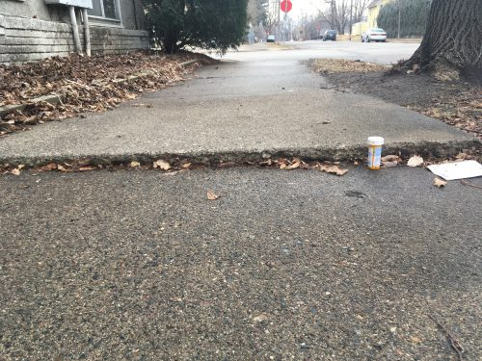



Container Orchestration & Reliability
Designing with the knowledge something will fail at any point

Slide 26
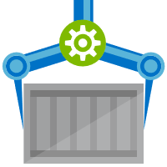


Orchestration Provides Infrastructure Resiliency
Release Management
Resource Pool
Orchestration
HOST-A
Deploy:
web:1 x3
quotes:1 x3
important:1 x4
Image Cache
web:1
digest: 91e
web:1
digest: 91e
Foo:
web:1 x3
quotes:1 x3
important:1 x4
web:1
digest: 91e
quotes:1
digest: u82
Container Builder
Container Registry
important:1
digest: 2re
important:1
digest: 2re
HOST-B
Image Cache
quotes:1
digest: u82
quotes:1
digest: u82
quotes:1
digest: u82
web:1
digest: 91e
important:1
digest: 2re
important:1
digest: 2re
important:1
digest: 2re
quotes:1
digest: u82
quotes:1
digest: u82
docker build –t web:1
docker build –t quotes:1
docker build –t important:1
docker push web:1
docker push quotes:1
docker push important:1
important:1
digest: 2re
important:1
digest: 2re
Image
web:1
quotes:1
important:1
Digests
91e
u82
2re
web:1
digest: 91e
HOST-C
quotes:1
digest: u82
Image Cache
important:1
digest: 2re
quotes:1
digest: u82
quotes:1
digest: u82
important:1
digest: 2re
important:1
digest: 2re
Notes:
Orchestrator icon from: http://cdn.marketplaceimages.windowsphone.com/v8/images/f58edb21-b20c-4315-b837-6cee21n442cd?imageType=ws_icon_large
https://git-scm.com/book/en/v2/Git-Branching-Basic-Branching-and-Merging

Slide 27

Apology Based Computing
Pat Helland
https://www.linkedin.com/in/pathelland/

Slide 28
Inventory and Forklifts
Even if the computer is accurate:
Data are entered by people
Data are entered by sensors
Decisions are made
-- “Jim wants to buy a book!”
-- “Hey, we have one in Nevada!”
-- “Ship it to him… should be there on Tuesday!”
In preparing the book for shipment, the only copy is run over by the forklift in the warehouse… bummer.

Slide 29
Guessing and Partial Knowledge
Computers have partial knowledge
Will be separated from the real world
May be separated from other replicas with opinions of their very own
Computers do not make decisions!
They try to make decisions
The best you can do is a guess!
Good guesses; bad guesses; no certainty…

Slide 30
Memories and Sharing
It’s nice to remember your guesses
Makes it easier when you guessed right
Makes it easier when you guessed wrong
Usually, computers remember their guess…
Sharing your memories is useful
Replicas, disaster protection, yada-yada-yada
Fidelity of memories ←→ cost
More money, less forgetfulness
More replicas
Longer latency to share across replicas before emitting guesses…
Investing in remembering well is a business decision
Maybe forgetting once in a while is cheaper!

Slide 31
Screw-Ups and Apologies
I guess I can ship that book on Wednesday…
Sorry!!! Current guess is next month!
Oh,
Crap!
Indistinguishable behavior!!!
I guess I can ship that book on Wednesday…
Replica 1
User 1
Sorry!!! Current guess is next month!
I guessed I would ship the book
User 2
Replica 2
I guess I can ship that book on Wednesday…
31

Slide 32
It’s OK to be Decisive and Wrong
Business involves apologizing…
It’s OK to take advantage of that!
Pay attention to the cost (and probability) of the apology versus the advantage of decisiveness
32

Slide 33


“Banks can run their core system on-premise, while still managing marketplace applications on the cloud. We are facilitating their controlled exposure to the cloud, and that’s exciting.”
Félix Grévy
Global Head of Product Management

Slide 34
















Pipelines
ACR
Azure Kubernetes Service (AKS)
Load Balancer External
Active Directory
Virtual Network
API Mgmt
Namespace
Namespace
…
Namespace
Load Balancer Internal
VM
VM
VM
VM
GitHub
…
Express Routes
On-prem services
Infrastructure
Cosmos DB
SQL Server
Application Insights
Key Vault
Log Analytics
Container Monitor
Terraform

Slide 35
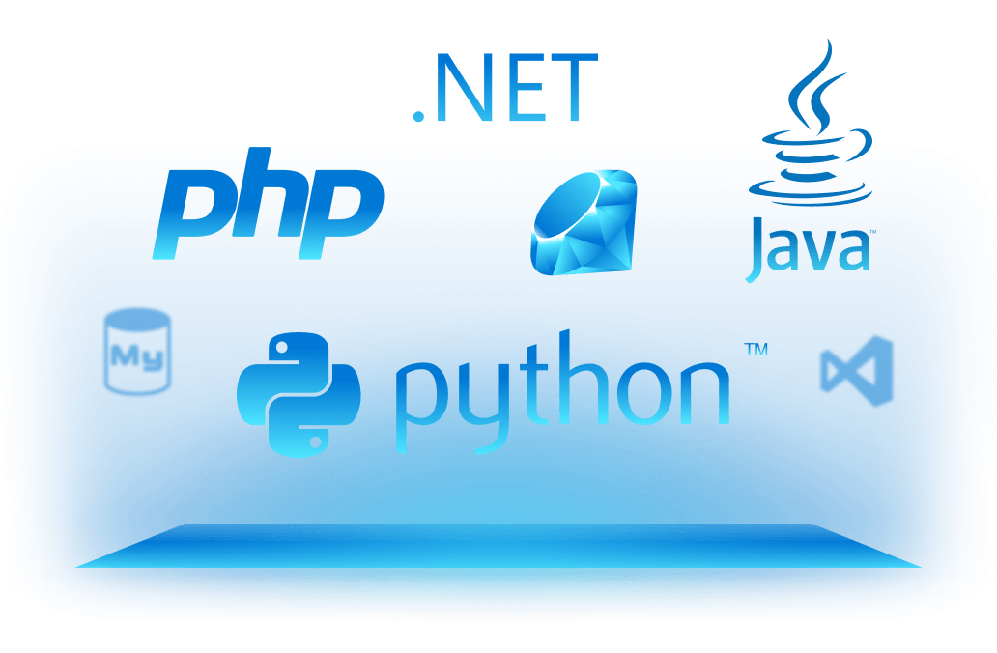
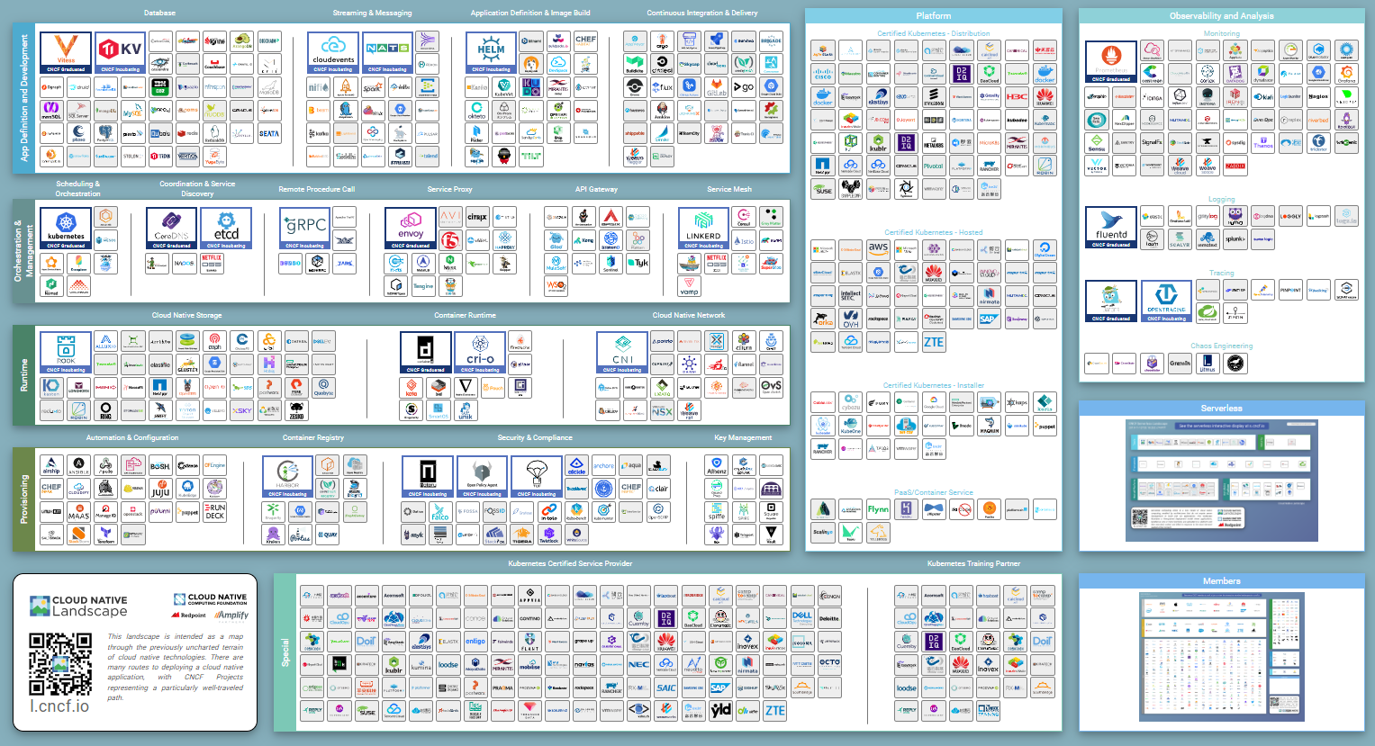
Choice…
Development Tools
Develop in your favorite language
With your favorite tool
Using the components and services that make sense for your team
Components
Builds
Stability
Source Control
Release Management
Secret Management
Find a point of stability, giving a central place to look for incoming and outgoing
Services

Slide 36
Cloud Native Enables Choice

Slide 37

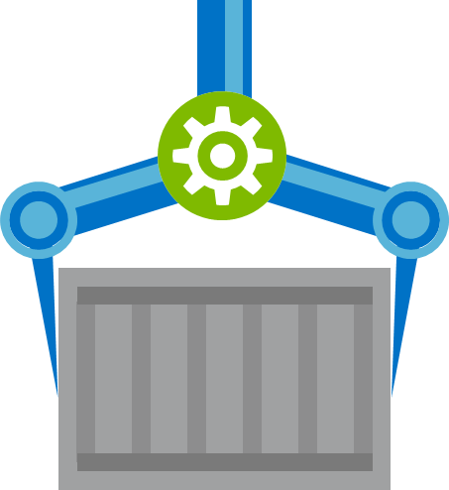

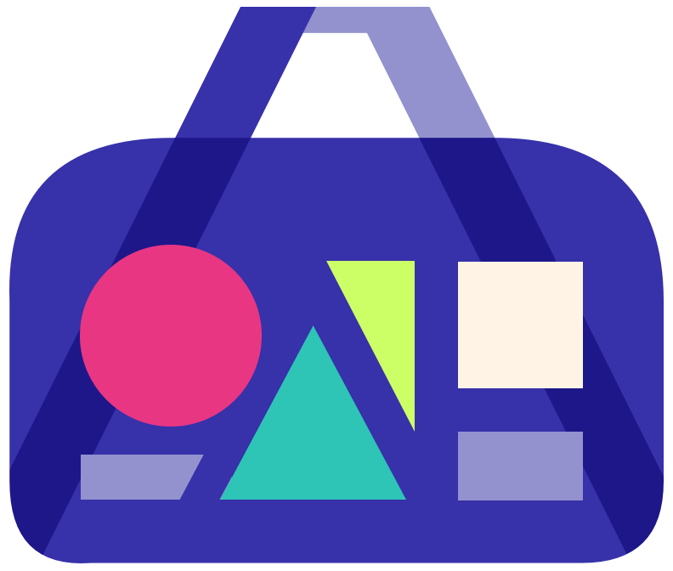
Build
Test
Deploy

Slide 38

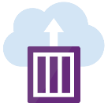






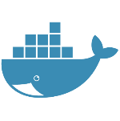






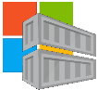


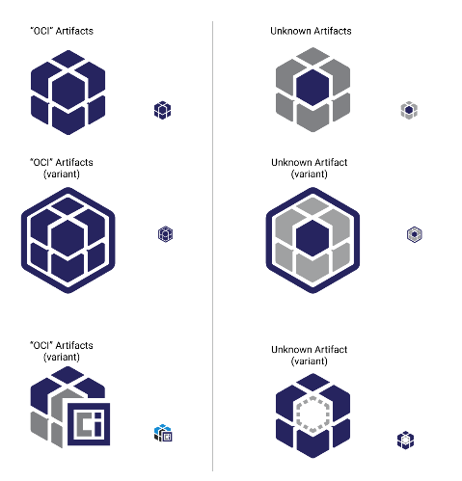


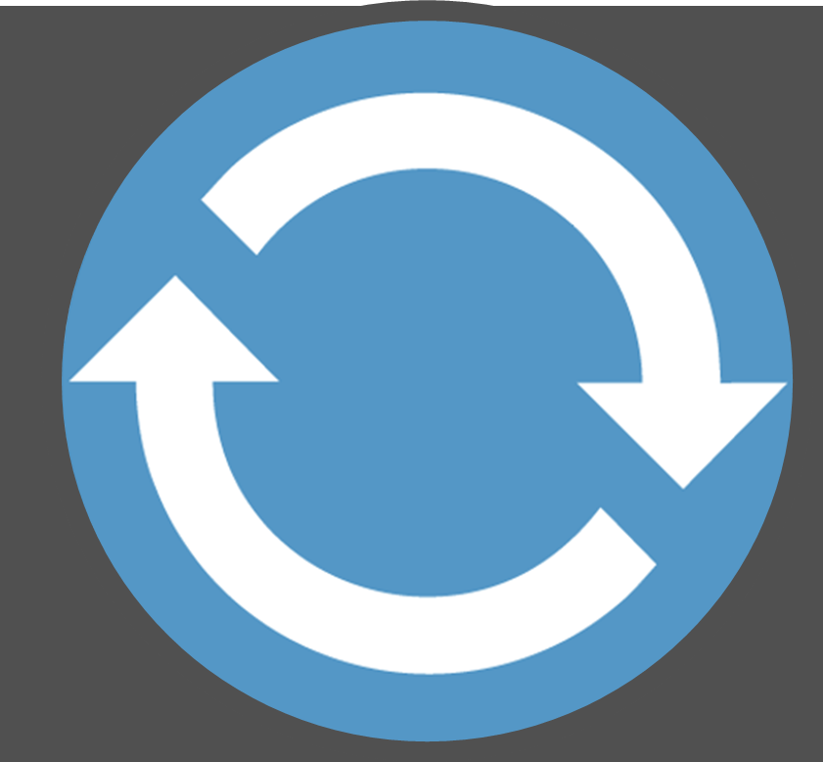
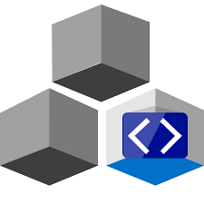

Build, Test, Deploy
Deployments triggered on artifact availability
Secrets
Config
SCC
Source Code ControL
CI
Build, Unit & Integration Testing
Prod
CD Deployments
Virtual Build & Test Environment
Unit Testing
Staging
Helm Chart,
CNAB
Functional Testing
Dev Registry
Staging/Prod Registry
Docker Hub
Artifact Security Scanning
git commit
ACR Tasks
Azure Container Registry
ACR Tasks
Azure Container Registry
Microsoft Container Registry
Inner-Loop
OCI Artifacts
Dev
Run
Code
Validate
Debug
Azure DevSpaces

Slide 39
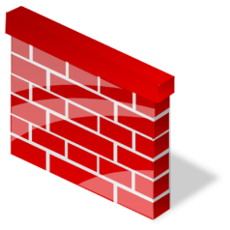
Security Boundaries
Secrets
Config
SCC
Source Code ControL
CI
Build, Unit & Integration Testing
Prod
CD Deployments
Virtual Build & Test Environment
Staging
Staging/Prod Registry
Docker Hub
git commit
ACR Tasks
Azure Container Registry
Microsoft Container Registry
Rules
Inner-Loop
IP: 5.5.1.2
Dev
Dev Registry
Run
Code
Validate
Debug
Azure DevSpaces
ACR Tasks
Azure Container Registry

Slide 40
Post Development
Secrets
Config
OS & Framework Patching
What happens when developers stop making code changes?
CI
Build, Unit & Integration Testing
Prod
SCC
Source Code ControL
CD Deployments
Virtual Build & Test Environment
Staging
Staging/Prod Registry
Docker Hub
git commit
ACR Tasks
Azure Container Registry
Microsoft Container Registry
Inner-Loop
Dev Registry
Dev
Run
Code
Validate
Debug
Azure DevSpaces
ACR Tasks
Azure Container Registry

Slide 41







Container Patching
Secrets
Config
Unit & Functional Tests provide value for the life of the application
CI
Build, Unit & Integration Testing
Prod
SCC
Source Code ControL
CD Deployments
Virtual Build & Test Environment
Unit Testing
Staging
.NET
Staging/Prod Registry
Functional Testing
Docker Hub
Base Image Index
ACR Tasks
Azure Container Registry
Microsoft Container Registry
Central Base Artifacts
Base Image Index
CI
Build, Unit & Integration Testing
ACR Tasks
Azure Container Registry
Unit Testing

Slide 42
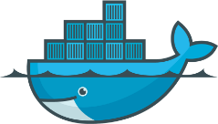
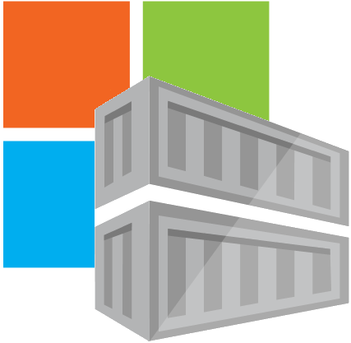
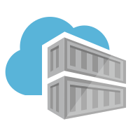

Container OS & Framework Patching
Triggers
Registries
Docker Hub
MCR
ACR
SCC Providers
ACR Tasks
Azure Container Registry
Timers
aka.ms/acr/tasks

Slide 43
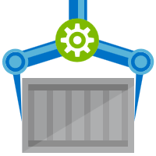

Demoing Base Image Updates
Public Registries
Your Environment
demo42.azurecr.io/hub
Private Registry
demo42.azurecr.io
Docker Hub
Public Internet
Task Image Validation
node
java
MCR
dotnet
ACR Tasks
wordpress
base-artifacts
node
java
dotnet
wordpress
dev
faclon-team
Helloworld digest: 91e
warriors-team

Slide 44
Demo
Event Driven Image Building…
ACR Tasks
A primitive of container lifecycle management

Slide 45
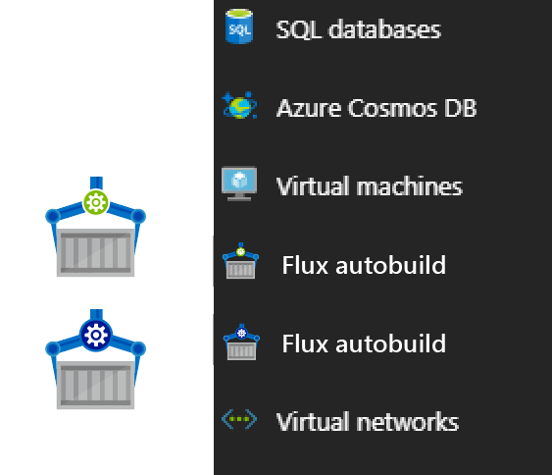







Contoso (Returns)
1 Pull Request
= 1 Build
= 1 Push
= 1 Scan
= 1 Test
= 1 Deploy
$$(1pr=1b+1p+ 1t+1d) ∗life of development$$
Contoso (*)
= 1 Build
= 1 Push
= 1 Scan
= 1 Test
= 1 Deploy
= 1 Build
= 1 Push
= 1 Scan
= 1 Test
= 1 Deploy
= 1 Build
= 1 Push
= 1 Scan
= 1 Test
= 1 Deploy
.NET
Northwind
= 1 Build
= 1 Push
= 1 Scan
= 1 Test
= 1 Deploy
= 1 Build
= 1 Push
= 1 Scan
= 1 Test
= 1 Deploy
= 1 Build
= 1 Push
= 1 Scan
= 1 Test
= 1 Deploy
Smart Hotel 360
= 1 Build
= 1 Push
= 1 Scan
= 1 Test
= 1 Deploy
= 1 Build
= 1 Push
= 1 Scan
= 1 Test
= 1 Deploy
= 1 Build
= 1 Push
= 1 Scan
= 1 Test
= 1 Deploy
Adventure Works
= 1 Build
= 1 Push
= 1 Scan
= 1 Test
= 1 Deploy
= 1 Build
= 1 Push
= 1 Scan
= 1 Test
= 1 Deploy
= 1 Build
= 1 Push
= 1 Scan
= 1 Test
= 1 Deploy
Fabrikam
= 1 Build
= 1 Push
= 1 Scan
= 1 Test
= 1 Deploy
= 1 Build
= 1 Push
= 1 Scan
= 1 Test
= 1 Deploy
= 1 Build
= 1 Push
= 1 Scan
= 1 Test
= 1 Deploy
$$1patch=cust ∗apps ∗ \left(1b+1p+ 1t+1d\right)∗life of the app$$

Slide 46


Additional Elements
Diagnostics & Logging
Event Driven
Security Scanning
Geo-replication
Outages and recoverability
Idempotent Execution
, …everywhere

Slide 47



Azure Dev Spaces Iterative Kubernetes development for teams
Familiar Dev Experience
End-to-end Testing
http://frontend...aksapp.io
FrontEnd
Service-B
Service-C
http://susie.s.frontend...aksapp.io
Service-B
Susie’s version
Susie Walter
Notes:
"Familiar dev experience" resonates most with developers new to Kubernetes and who value a familiar experience where you can open a VS project, hit F5, step through code in the debugger.
"End-to-end testing" resonates with customers who are further along in their journey of adopting microservices and who are now dealing with the challenges of a more complex environment where there are many moving parts.

Slide 48
Cloud Native Is
Infra Deployed Through APIs Deployments are software requests, not hardware purchase ..
Automation
All process, from build, patching, test, . deployment are automated
Serverless
Instancing infrastructure, on-demand, paying . for usage over reserved capacity .
Microservices
Loosely coupled services, using fire & forget queue processing with apology-based transactions
Containers.
Standard deployment format to. abstract code from underlying. infrastructure differences
OSS
Embraces community projects to speed development
Failure As A Design Principal .
Standard deployment format to abstract code . from underlying infrastructure differences
Polyglot
Mixture of languages & runtimes, tailored to the development team, and/or task being done
Notes:
SPEAKER: What is cloud native
‘Cloud-native’ is an adjective that describes the applications, architectures, platforms/infrastructure, and processes, that together make it economical and possible for us to quickly respond to changing landscape and growing customer needs.
In simple terms, it is application code and dependencies packaged in containers, deployed as microservices, and exposed as APIs. And you can manage them using DevOps processes and tools.

Slide 49






Best support for your enterprise need
Learning path aka.ms/LearnKubernetes
What is Kubernetes aka.ms/k8sLearning
Hear from experts aka.ms/AKS/videos
Case studies aka.ms/aks/casestudy
Azure Kubernetes Service aka.ms/AKS/page
Try for free aka.ms/aks/trial
Feedback on the roadmap? Tell us at https://aka.ms/aks/feedback

Slide 50




Thank You
AKS Learning path aka.ms/LearnKubernetes
AKS Videos aka.ms/aks/videos
Try AKS aka.ms/aks/trial
ACR Tasks aka.ms/acr/tasks
Presentations aka.ms/acr/presentations
Steve Lasker
Program Manager
Azure Container Registries
Steve.Lasker@Microsoft.com
@SteveLasker
SteveLasker.blog
github.com/SteveLasker
github.com/SteveLasker/presentations

Slide 51
